Slide 1
Forms

Slide 2
Agenda
Forms
Sample output
Forms implementation

Slide 3
Forms
Forms are used to collect information, store in database and use it for various purposes.
We use forms tag to wrap all the information at one place so that forms can send information to some other files(javascript, backend..,) with the help of a button in forms tag.
If we do not have backend, the information is submitted to the same page.
To forward information to different page, we use action property in form tag.
The form values are rendered with the help of AJAX calls(Asyncronorous Java Script and XML call).
Syntax:
<form action=”file name”>
All your details here with submit button.
</form>

Slide 4
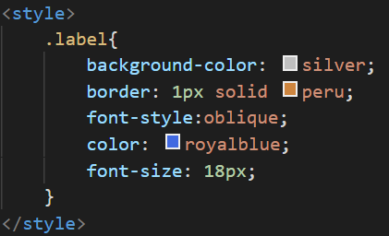
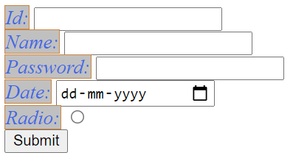
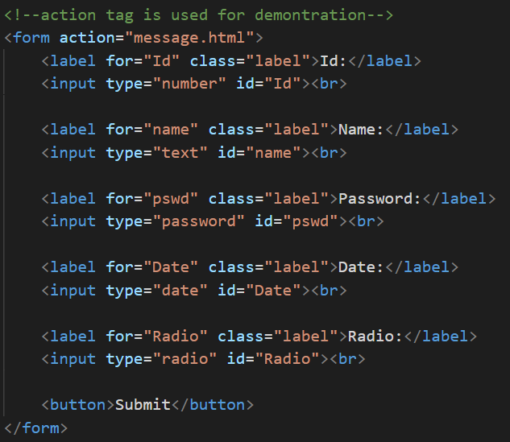
Sample output

Slide 5
Forms implementation
Let’s see implementation of forms in HTML.

Slide 6
Summary
Forms are used to wrap information and send it to other pages.
We have seen the implementation of the same.
DO NOT WRITE ANYTHING
HERE. LEAVE THIS SPACE FOR
WEBCAM

Slide 7
Thank You
Proprietary content. ©Great Learning. All Rights Reserved. Unauthorized use or distribution prohibited

